Slide 1
Things to talk about with Eric
Skype mtg, 4-March-2015
~5 mins: Hi!, how’s Maryland, etc.
~10-15 mins: A few Qs about methane results
~10-15 mins: Referee report, review paper “getting on the same page,” etc.
~5 mins: Any last words
Try to keep this mtg closer to 30 mins, since Eric is hella busy

Slide 2
Methane stuff

Slide 3
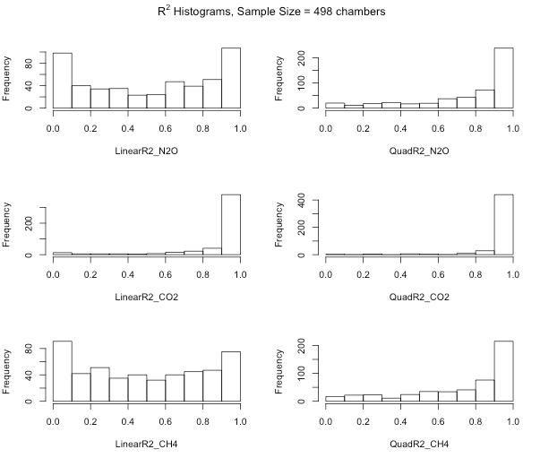
Linear R² values for methane are not much worse than N₂O
CO₂ R² value of 0.7 ok for deciding when to throw out a chamber?
Notes:
- To find that cut-off R^2, look through the slope values and the 95%CI value for the slope and find the R^2 that goes with the point where the CI>slope
- Another pass through to look at things to throw out, look at every N2O or CH4 slope for a chamber with a flux > 2 st deviations from the mean, and visually inspect to see if there is 1 vial that threw off the regression; make a judgement call (ok to keep the other two flux values if this happens)

Slide 4
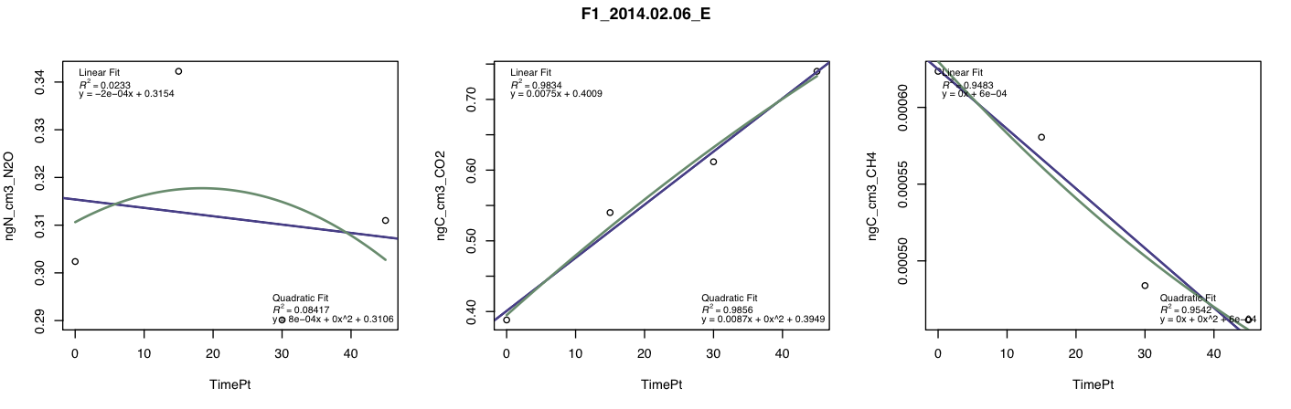
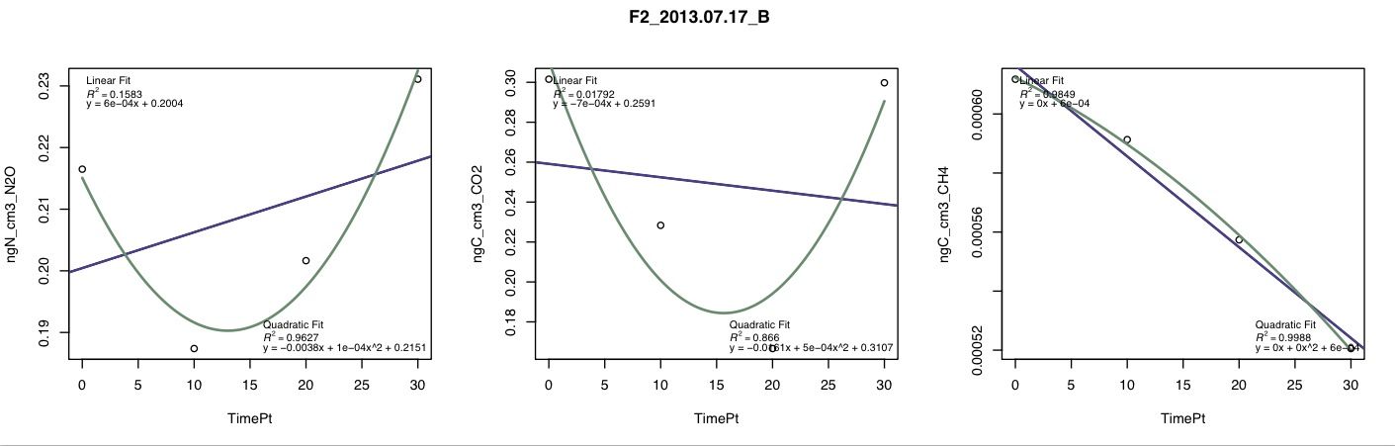
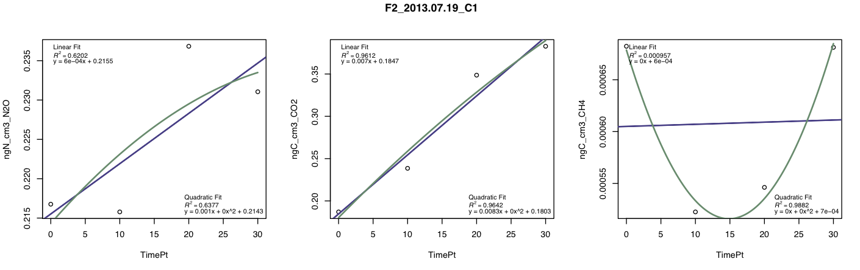
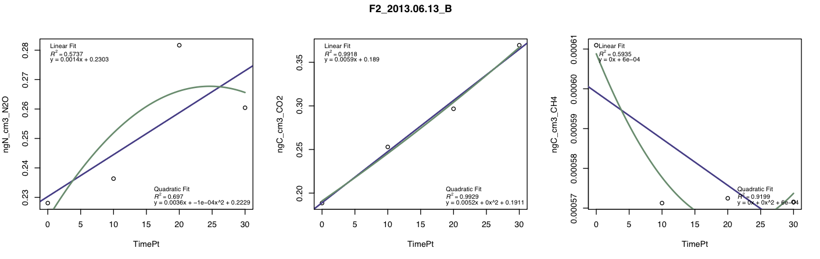
Some of these fits are pretty terrible – why would N2O and CH4 sometimes be terrible on their own without the other also being terrible? Eric said previously that if the CO2 fit is good, the N2O data stays in the dataset. I’m planning to follow the same rule for CH4… sound right?
Notes:
Eric note: I should make these graphs with concentration on the y-axis (ppm), instead of mass/volume
To know about the CH4 in row3 – is .00010 a huge swing, or a swing that’s basically nothing? What are avg meth uptake rates in seasonal trop forests? Because if that swing is peanuts, then you’re possiblymeasuring a “true” zero.
4th row – potential links = water/oxygen mechanism, nh4 mechanism; in situations where available C limits N2O, that should decouple N2O and CH4

Slide 5
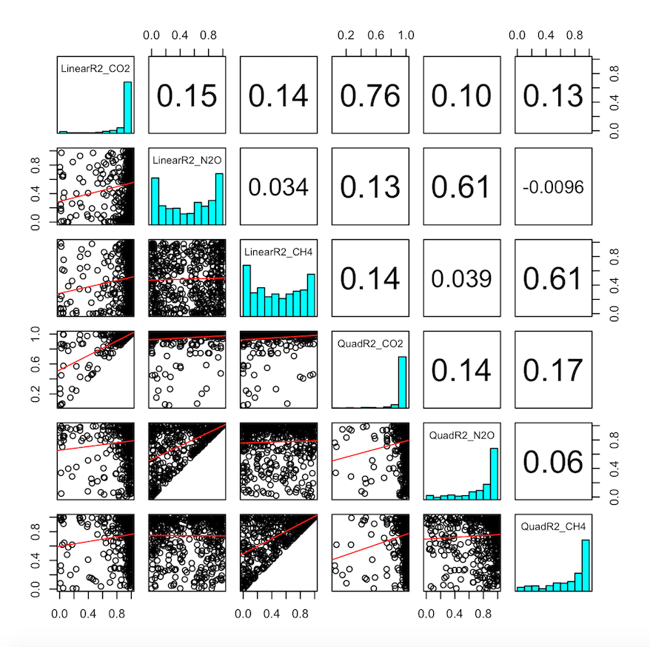
Eric, does this pass your sanity check that there are few biological reasons that CH4, CO2 and N2O should be correlated?
Sarah and I brainstormed two reasons why CH4 and N2O would be negatively correlated – WFPS/anoxia and NH4 availability (see next slide)
Notes:
Eric says this makes sense; maybe sometimes CO2 and CH4 are pos correlated because the high resp rates uses up all the oxygen – maybe look anecdoatlly at the v. high CH4 prod chambers

Slide 6
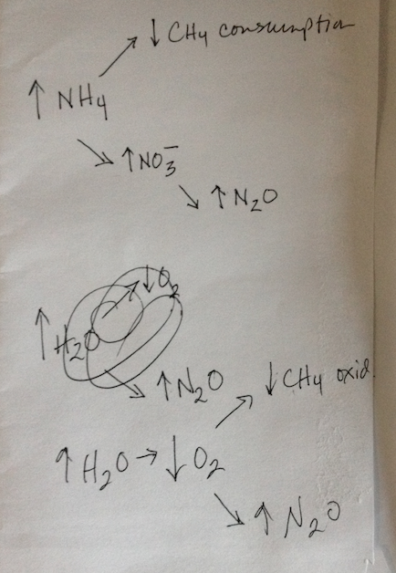
Notes from Sarah mtg are in the comment boxes of various slides in this ppt. This image will help explain the notes in the comment box on the previous slide about CH4-N2O biological links:
(Ignore, this was a random distracting scribble that I whited out after I scanned the scrap paper)

Slide 7
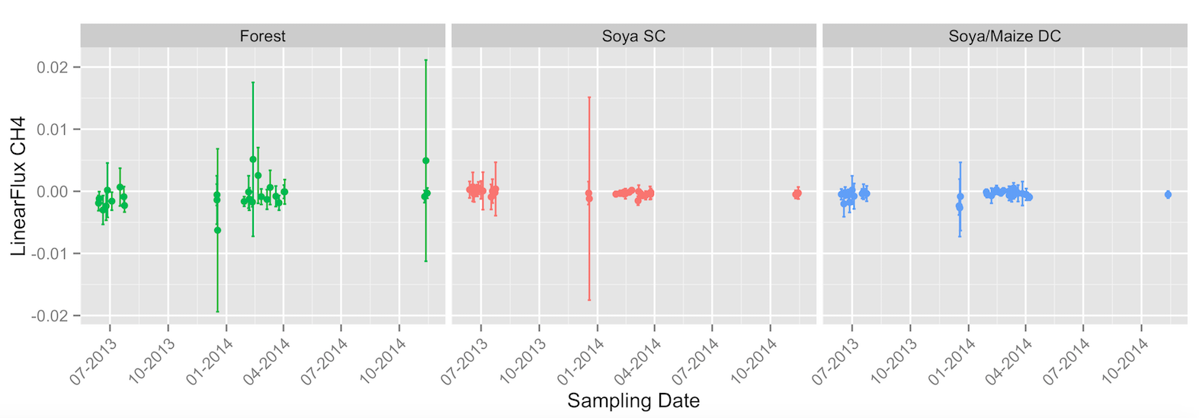
Actual results --- OK, so looks like weak methane uptake in both ag systems, and more clear uptake in forests. But standard deviations are consistently crossing zero. Ugggggggg – how to interpret when we already know that there are clear chamber to chamber differences?
Notes:
Error check – Look at every point that has a huge error bar and look at all five chambers at once for that point, for the sake of confidence
Convince yourself there’s no temporal trend – throw them into a regression with fluxes vs. time, do the same for each season, do an ANOVA to see if there is a significance of season. And if none of this is true, then we can take one huge average for an annual flux number
Before I do those tests, check normality assumption, if violated, do a log transformation (don’t forget to add an integer so you’re not taking the log of a negative number since you have some negative fluxes)
If you do this, then you’re going to graph a geometric mean instead
Fix that methane constant – how big are these fluxes in compared to other similar sites
Ask Eric and Rod how they go about showing this kind of data – how to distinguish between the replicates of each LU type? Ask Becca Ryals what she’s done.

Slide 8
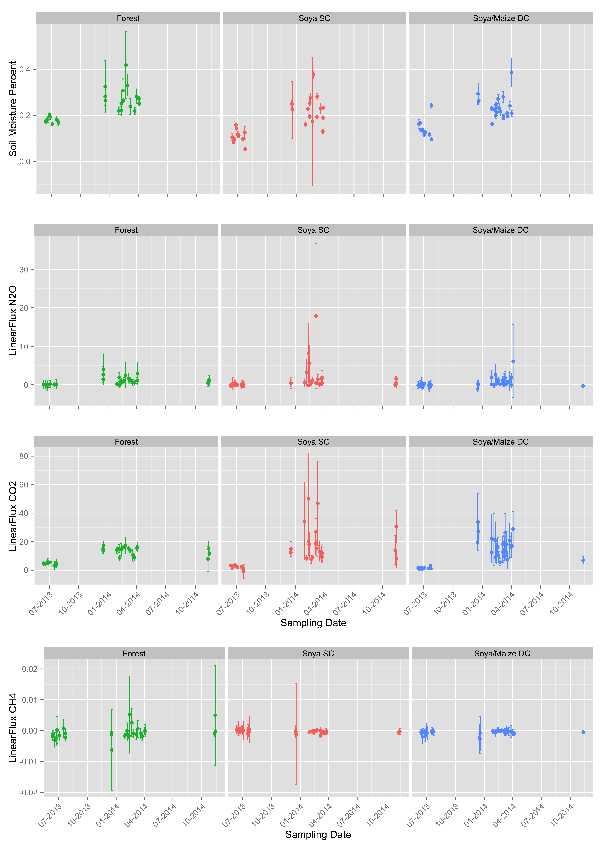
So we can compare to the other trace gases.
Notes:
- Maggi puts on 70kg/year of N fertilizer, so that should be a lot more than the forest has in standing stocks, and there’s way less opportunity for uptake in the fields, since there are fewer plants
- Check out the N min rates (N/ha/year mineralized) as a background supply rate to have in my head

Slide 9
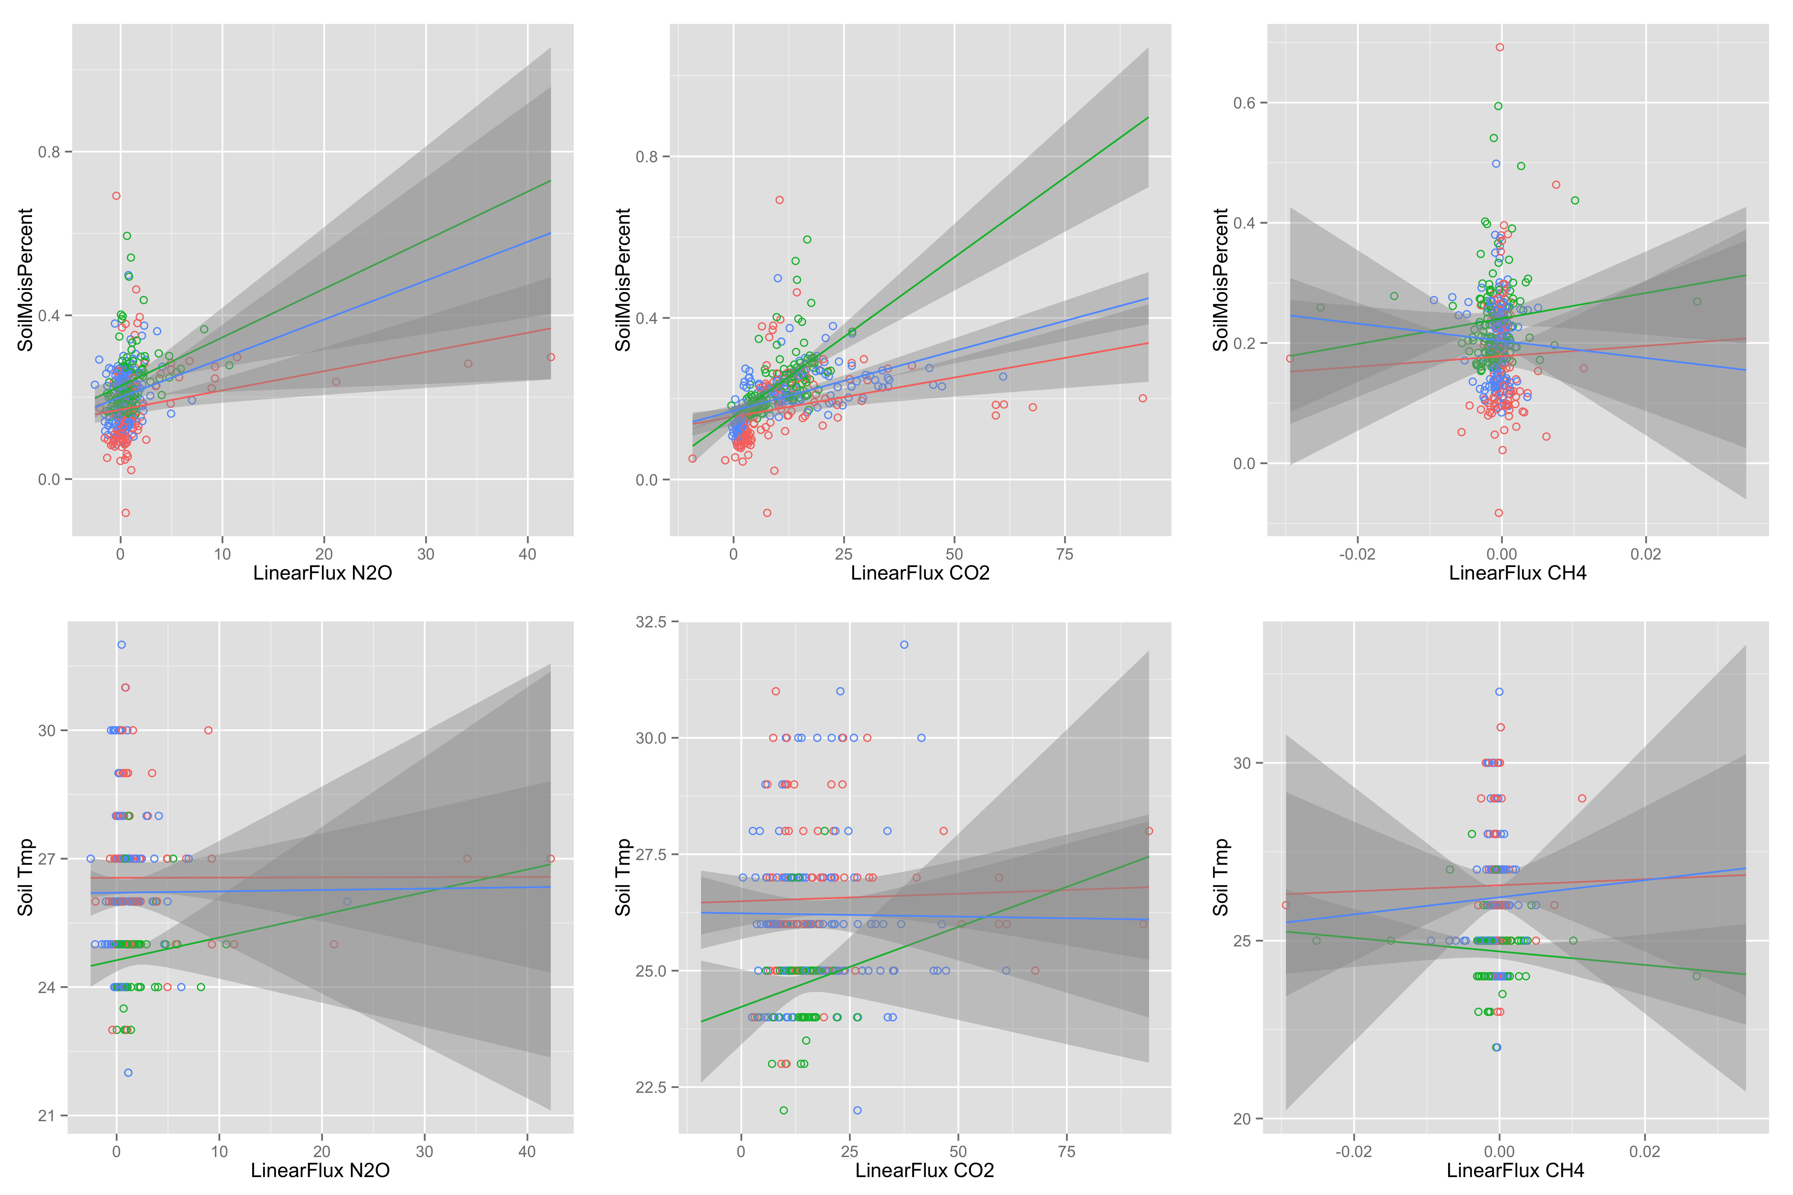
Moisture and soil temp relationships
Notes:
Switch axes!

Slide 10
What to do about the extra extractions
Look at the data, check out their standard curves and my blanks – maybe able to diagnose the problem
What matrix did they do their standards in (salt concentration vs. my extracts)

Slide 11
Review paper stuff
Ideas that Eric brought up for our own twist on a tropical gaseous N losses review:
Include NO as well (enough papers?)
Calc and use WFPS as a predictor
Re-calc EFs minus BG emissions (which these authors will surely do before resubmission, no?)
Notes:
Maybe worth sending Mercedes an email – we’re seeing papers with low N2O, and you’re saying it’s because of high NO. How many papers are you aware of that have NO fluxes? If it’s more than a few than is it enough to try and put this paper together?
Good to make this point; do we have any additional data to make this with?
Take a look at the papers that her group has done to see how well this point has been made/who cites those papers
You could do this for NO and N2O papers not together and you can’t compare within site, but just do two meta analyses separately
“Even though these are different sites, the effect size is so large that you can say that these are different”
First pass: look at Bustamante family of papers, plus who cites them, what’s your N, can you pull off finding an NO EF
Figure this out, make a judgement call from there
We should probably only do this if we can take the NO angle, since that’s a totally different paper.

Slide 12



Alternatively… impacts on N and P after conversion to ag/ag left fallow?

Slide 13
Help????
Take notes here about what Eric thinks about the review. SOAK UP WISDOM.

Slide 14
Wrap up
Reminder slide so I don’t forget to wrap up the agenda appropriately
Christine to do:
Send Mercedes an email
Look into the first-pass NO calcs to see if the review is viable
Take a break from N2O paper, come back to it after other chapter is in

